Slide 1

WEEK THREE
Winter 2020

Slide 2
Lecture Map
Attention Theory
There are different models from different perspectives
Baddeley’s Cognitive Process Model is seminal
Clinical models of attention list key areas that can be disrupted
Overview of Attention Assessment
Standardized test battery: TEA
Questionnaire: ARM; Clinical Interview
Overview of Attention Treatment
Six intervention options
Direct Attention Training

Slide 3
Let’s monitor our own attention during lecture
Interval | Sustained Attention Rating | Working Memory Rating | Using Any Strategies?
1
2
3
Rating: 1=Very low; 5= Quite High

Slide 4

Not a unitary concept
There are many different componential models that are derived from a different theoretical perspectives

Slide 5
Factor Analytic
Models
ATTENTION
MODELS
Cognitive
Processing
Models
Neuroanatomic
Models

Slide 6

Attention consists of three separate underlying networks
Alerting: Maintain an alert state(modulated by norepinephrine systems/frontal & parietal cortex)
Orienting: Focus our senses on target information (modulated by acetycholine/superior colliculus, pulvinar, frontal eye fields, temporal parietal junction superior parietal)
Executive attention: controls emotions & other processes (modulated by dopamine/anterior cingulate, lateral prefrontal basal ganglia)

Slide 7

Description of WM
Multiple systems necessary for successful storage and retrieval of info
Set of processes that permits us to hold on to info until it is utilized or encoded or allows us to store it until we want to access it
It is the term used to talk about all of the temporary storage and retrieval systems

Slide 8

Central Executive
directs our ability to focus, divide, and switch attention
Little capacity for storage but regulates selection and focus
Three “slave systems”
phonological loop & visuospatial sketchpad direct verbal & sensory info into cog processing system
Episodic buffer allows for integration of incoming stimuli with stored stimuli

Slide 9
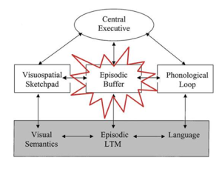

Slide 10
https://workingmemoryrst.wordpress.com/the-central-executive-system/

Slide 11

The Multitasking Myth

Slide 12

Can you fill in our attention model components?
(Sohlberg & Mateer, 2010)
Deployment of attention
Capacity
Resistance to interference
Mental manipulation
(Mateer & Mapou, 1996)

Slide 13
Most models incorporate…
Maintenance/Sustaining attention
Attentional selectivity
Attentional capacity
Attentional control or shifting
These seem to be key theoretical concepts with a high degree of clinical significance

Slide 14

Focused
Sustained Attention
Working Memory
Suppression
Alternating
Selective(Sohlberg & Mateer, 2010)

Slide 15

TBI
ADHD
Cancer survivors
Fetal alcohol syndrome
RHD
Aphasia

Slide 16

A growing acquired condition that results in attention deficits
CNS treatments for leukemia and brain tumors affect neuropsychological development
Consistent pattern of deficits involving vigilance, working memory, spatial awareness, processing speed and self monitoring

Slide 17
Fetal Alcohol Syndrome
ADHD is most prevalent symptom
Attention deficits are stable over time
Working memory, inhibition, sustained and selective attention frequently implicated (Vernescu, 2008)
Notes:
.

Slide 18
Right Hemisphere Disorder
Attentional deficits (Focused, Sustained, Selective, Alternating)
Left neglect
Visuoperceptual deficits
Notes:
.

Slide 19
Aphasia
Growing evidence that individuals with aphasia exhibit deficits on a variety of attention tasks (orientation, sustained, selective, divided)
Attentional models of aphasia propose that some aphasic symptoms are actually a product of attention impairments
Resource Allocation Theory (McNeil et al, 1991)

Slide 20
Bottom Line…
A number of developmental and acquired conditions have attention deficits as a primary symptom

Slide 21

Traditional testing is inappropriate as a sole method for planning treatment and does not map onto client needs and skills
BUT…
Helpful for establishing level of attention impairment
Standardized tests may help sort out the nature of an attention problem and provide treatment ideas. Think of the hypothesis testing model
Is it a memory or an attention problem?
Is it modality specific?
Is it speed of processing or a capacity issue?
How impaired is the attention?

Slide 22
Hypothesis Testing
Is it a language problem or a specific attention problem?
Test the hypothesis by___________
Is it a selective attention problem or a sustained attention problem?
Test the hypothesis by_______

Slide 23
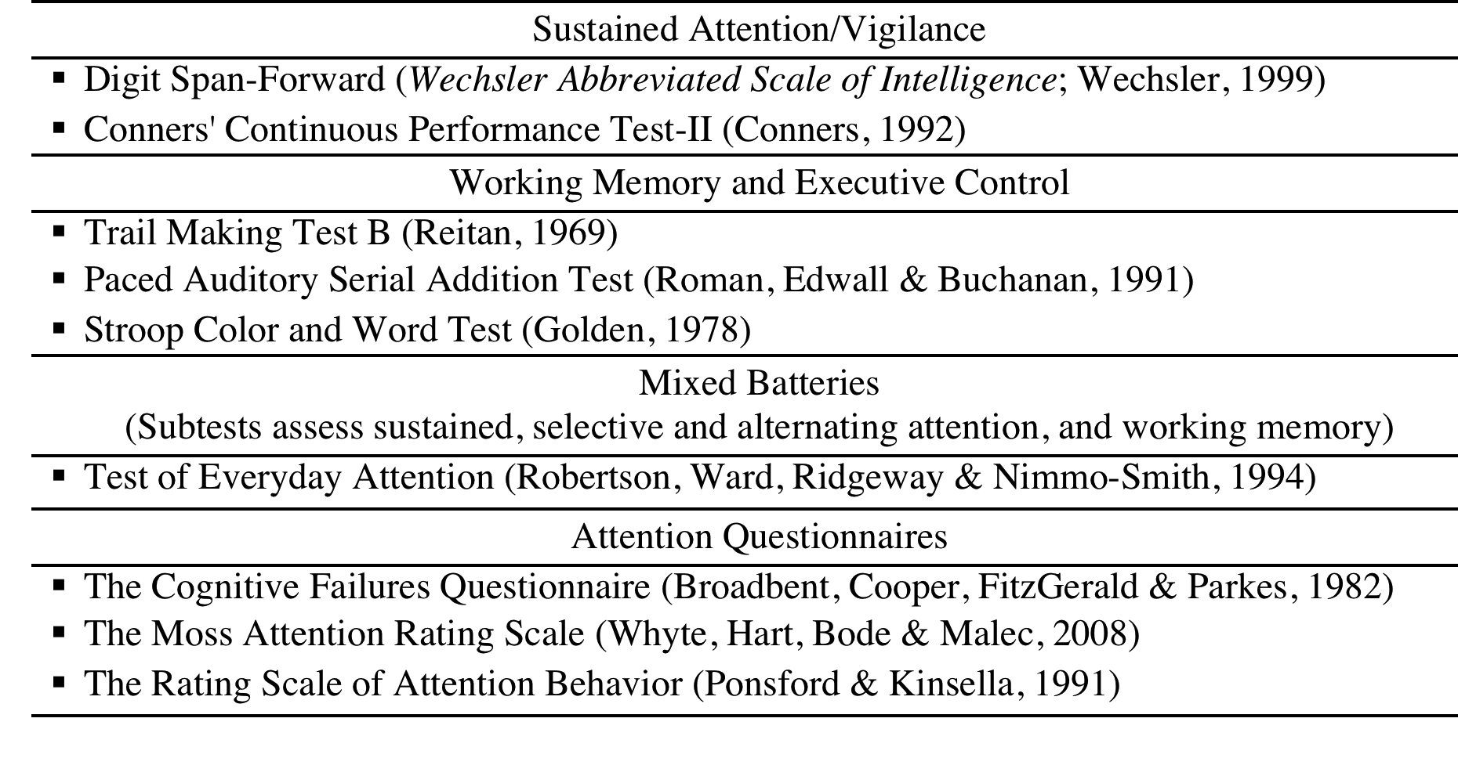
Attention Tests

Slide 24
Test of Everyday Attention
Subtests measure: sustained, selective attention, switching attention, and divided attention
Takes 45-60 min to administer
Designed to have subtests measure attention systems that are separable attention systems in the brain
There are three versions of the test

Slide 25
Test of Everyday Attention: 8 subtests
Map search: search for symbols in an array (selective attention factor)
Elevator counting—count tones and keep track of floor (sustained attention factor)
Elevator Counting with Distraction—ignore high tones. (Auditory-verbal memory factor, selective attention factor)
Visual Elevator—Must count up and down as they follow a series of visually presented floors on an elevator. Self paced (attentional switching factor)

Slide 26
Test of Everyday Attention: 8 subtests
Elevator Counting with reversal—presented at a fixed speed. (auditory verbal working memory factor)
Telephone Search—Look for key symbols on a telephone directory (selective attention factor)
Telephone Search while counting—search phone book while counting tones (divided attention—dual task).
Lottery-Listen for winning numbuer in a 10 minute series of tapes—sustained attention factor

Slide 27
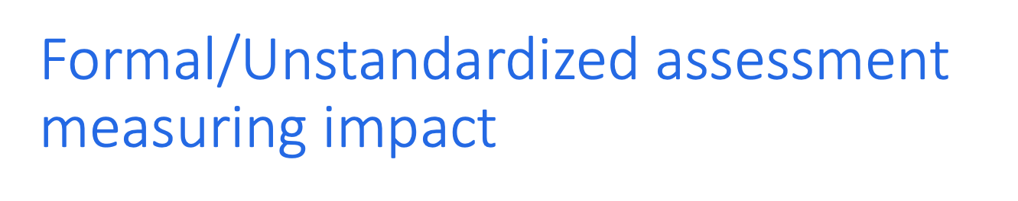
Attention Rating and Monitoring Scale Cicerone & Azulay (2002)Clinicial Neuropsychologist, 16, 280-289)
APT Questionnaire (Sohlberg & Mateer, 2001)
Questions organized into different attention areas
Frequency of occurrence scale
Informal portion to elicit specific contexts where problems affect functioning

Slide 29

Direct training of attention processes (APT; CogMed; Lumosity)
Specific skills training (e.g., a cooking routine)
Training of metacognitive strategies (orienting/pacing)
Training use of assistive technology( smartphone)
Environmental modification/task accommodation (communication board)
Personalized education (logging attention lapses and using data to make different choices)

Slide 30
DIRECT ATTENTION TRAINING
Treatment Components ➔
Assessment➔
Mechanism of Change ➔
General Approach➔
Drills, strategy training, self monitoring; (decontextualized drills only?)
Clinical Interview; Questionnaires
Identify attention profile and impact GAS
Test of Everyday Attention (battery)
Changes in Cognitive Processing (attention & self monitoring)
Neuroplasticity/restoratory
See APT-3 manual/principles
drills; repeated probes, GAS

Slide 31
Attention Training
Based on the premise that attentional abilities can be improved by activating particular aspects of attention through a stimulus drill approach
Repeated stimulation of attentional systems via graded attention exercises is hypothesized to facilitate changes in attentional functioning (process-oriented/impairment-based/decontextualized)
Includes targeting functions related to sustaining attention over time (vigilance), information processing capacity and speed, shifting attention, resisting distraction
Mostly based on the adult attention rehabilitation literature

Slide 32

Key mechanisms: modification of synaptic connectivity
Plasticity appears to operate differently depending upon the specific neural network; experience induced functional changes occur the most rapidly in motor, language and visual systems after stroke

Slide 33
Neuropsychological Rehabilitation: An International Journal
Volume 26, Issue 5-6, 2016 Special Issue: Brain Training. Guest Editors: Caroline M. van Heugten, Roy P.C. Kessesl, and Rudolf W.H.M. Ponds
“It was concluded that computerised cognitive training may offer the most benefit when incorporated into a therapeutic milieu rather than administered alone, although both appear superior to more generic forms of cognitive stimulation”.
More research is needed to evaluate the clinical
relevance of these findings and to identify
participant characteristics that are predictive of
training gain.”
“This study highlights the need for individualised rehabilitation of
attention to improve everyday functioning after TBI.”

Slide 34
My Own Evolution with Attention Process Training
Single subject multiple baseline
Adapted, individualized exercises
Standardized attention measure
Sohlberg, M.M., & Mateer, C. (1987). Effectiveness of an attention training program. Journal of Clinical and Experimental Neuropsychology. 9(2), 117-130.
Randomized crossover design
Adapted, individualized computer exercises
Neuropsych battery, EEG, unstructured interview
Sohlberg, M.M., McLaughlin, K.*, Pavese, A., Heidrich, A., & Posner, M. (2000). Evaluation of attention process training in persons with ABI. JCEN. 22(5), 656-676.
Pilot study pre/post
Adapted, individualized computer drills AND metacognitive strategy training
Neuropsych battery, Self and parent questionnaire, Goal Attainment Scaling
Sohlberg, M.M., Harn, B., MacPherson, H.*, & Wade, S.L. (2014). A pilot study evaluating attention and strategy training following pediatric traumatic brain injury. Clinical Practice in Pediatric Psychology. 2(3), 263.

Slide 35
Mechanism of Change is still Alteration of Cognitive Processing
Functional plasticity and recovery is use dependent
Requires paring sensory input with feedback top down modulation and training w/learning
Demonstration of plasticity depends upon the availability of sufficient residual neural resources
Participants motivation and attention are critical modulators of plasticity
NIH Blueprint for Recovery (2011)
https://neuroscienceblueprint.nih.gov/blueprint_basics/harnessing_neuroplasticity_workshop_report.htm

Slide 36
Consistent Themes Across the Literature
Proof of Principle | There’s evidence that repetitive drill based intervention can improve cognitive functions in individuals with acquired and progressive decline
Degree of Generalization? | May be limited to near transfer and like tasks
Inadequacy of Research Evidence | Need for larger, more well designed studies
Task Selection & Implementation Variables | Individualized and adaptive? Cognitive domain?(WM, attention, EF?) Dosage?
Pairing drills with strategy training | Need to consider self efficacy, engagement, strategy training
Measurement | Activity/participation as well as impairment based measures?

Slide 37
Without clear evidence… how should clinicians treat their clients now?
Generate hypotheses and measure carefully
We need practice-based evidence in this area

Slide 38
Hypothesis 1: Candidacy
Clients with consistent assessment results where client-reported concerns match neuropsychological tests
e.g.,BRIEF and PASAT both show WM deficits and client reports having trouble holding on to textbook info at school
Sufficient residual neural resources
Clients motivated and able to participate in impairment-based, drill oriented approach
Clients with readiness to change, self awareness
Serino, A et al. (2007). A pilot study for rehabilitation of central executive deficits after traumatic brain injury. Brain Injury, 21(1), 11-19.

Slide 39
Hypothesis 2: Active Ingredients
Repetition and high dosage
Adaptive training
Individualized training
Paired with strategy training (in order for wider generalization leading to functional change)
Facilitation of client engagement and self monitoring

Slide 40
Hypothesis #3: Not all Cognitive Domains are Equally Responsive or Equivalently Impaired
Working memory more amenable to change than memory
Some individuals struggle more with wm while others have more difficulty with sustained attention or speed of processing. Different attention profiles may respond to different tasks.

Slide 41
Hypothesis 4: Multilevel Outcome Measure Necessary to Analyze Change
Should be able to see changes on standardized tasks that use same processing
not clinically meaningful and the types of tests that improve for individuals may differ
If treatment beneficial, goals should be seen on GAS or patient reported outcomes that are
specific to activities or participation of concern to client
directly affected by cognitive area being treated

Slide 42
CASE EXAMPLE
Age: 15 year old male
Diagnosis: Mild-moderate TBI
Etiology/Initial Symptoms: Fall at school; Seen in ER with brief LOC; Memory, headache and concentration issues pronounced; admitted for observation
Initial Treatment: One week cognitive rest; school schedule modification with shortened day
Time since injury when seen at clinic: 5 months
Chief concerns: Attention/Concentration, Memory (learning efficiency) and Headache
School situation: Freshman at a high school arts program; high performing student
Psychosocial concerns: Solid friend group; positive outlook toward recovery

Slide 43
Goal Attainment Scaling Self Selected Therapy Goals
Level of Attainment | Goal 1 Improve Grades | Goal 2 Increase amount of time I can engage in quality guitar practice
Much more than expected + 2 | I will receive all A’s | I can practice 2,5 hours before I fade and stop benefitting
Somewhat more than expected + 1 | I will receive seven A’s and one B | I can practice 2 hours before I fade and stop benefitting
Expected level of outcome 0 | I will receive six A’s and two B’s | I can practice 90 minutes before I fade and stop benefitting
Somewhat less than expected - 1 | I will receive five A’s and three B’s | I can practice 60 minutes before I fade and stop benefitting
Much less than expected - 2 | I will receive no A’s | I can practice 30 minutes before I fade and stop benefitting

Slide 44
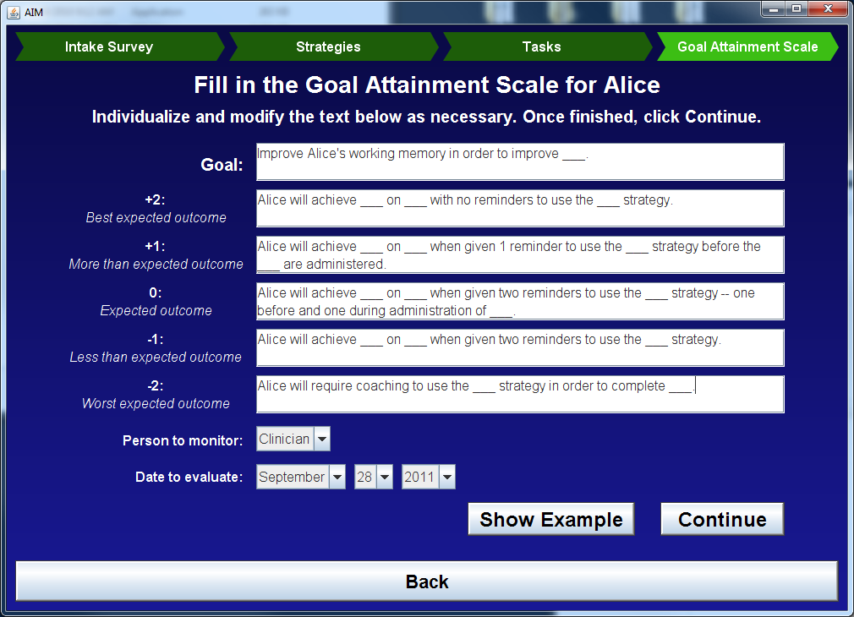

Slide 45
Treatment Approach—12 sessions including comprehensive assessment
Direct attention training
Hierarchical drills focusing on sustained attention and working memory
Metacognitive strategy training
Internal self talk during attention demanding tasks
Clarifying instructions
Concussion education—
http://headachereliefguide.com/

Slide 46
Outcome
Post-Concussion Symptom Scale reduced from 38 to 13
Test of Everyday Attention: Subtests in working memory and sustained attention improved significantly
Behavior Rating Inventory of Executive Function (BRIEF): significant improvements on Working Memory, Inhibition and Suppression Scores
Goal Attainment Score for grades: Met +2 (all A’s)
Goal Attainment Score for music practice Met +1 (practicing 2 hours)

Slide 47
APT/AIM Therapy Principles
Principle One: Organize Therapy Activities Using a Theoretically Grounded Model
Principle Two: Provide Sufficient Repetition
Principle Three: Use Patient Performance Data to Direct Therapy
Principle Four: Include Metacognitive Strategy Training
Principle Five: Identify and Practice Functional Goals Related to Attention

Slide 48
A Clinical Model of Attention
Focused Attention
Basic Sustained Attention
Maintain attention over time
Executive Control: Working Memory*
Executive Control: Alternating Attention*
Executive Control:Selective Attention*
Executive Control:Suppression*
*requires “executive control”; “complex attention”, “working memory” “resource allocation”

Slide 49

How do we select exercises and make decisions about when to stop or modify a program?
See criteria in APT-3 manual and think about when you might override these

Slide 50
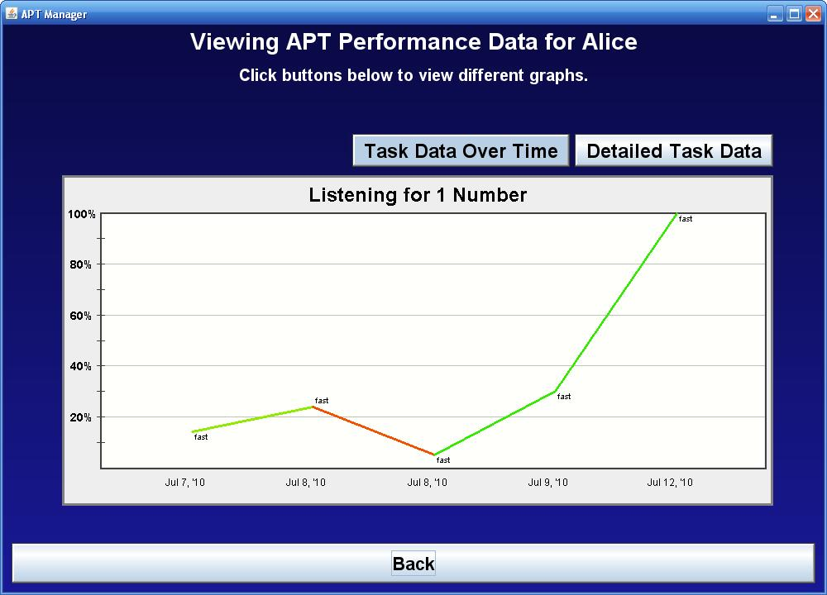

Slide 51
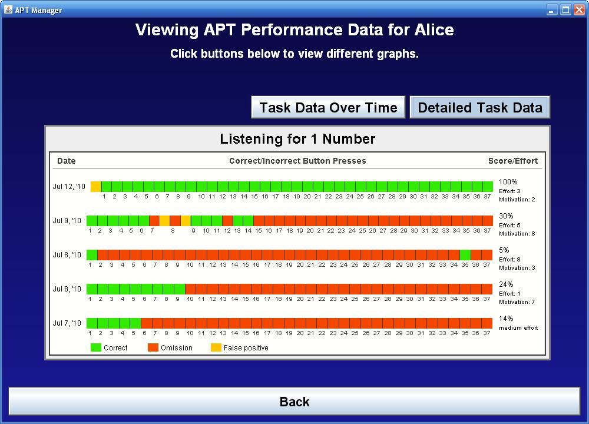

Slide 52

Importance of promoting engagement, effort
See APT-3 section on selecting strategies
Review strategy handout

Slide 53
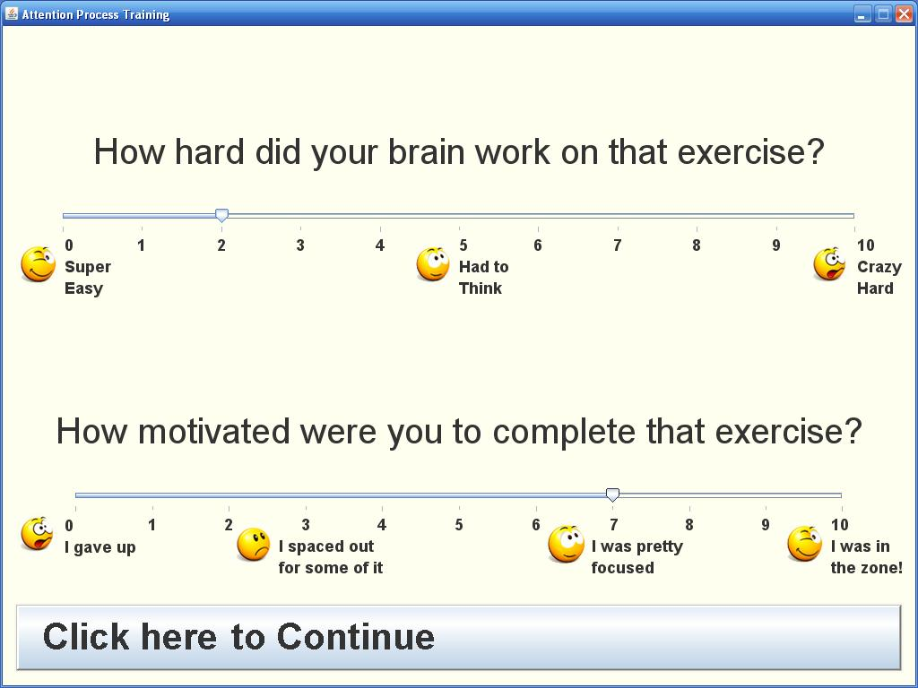
Effort/Motivation rating

Slide 54
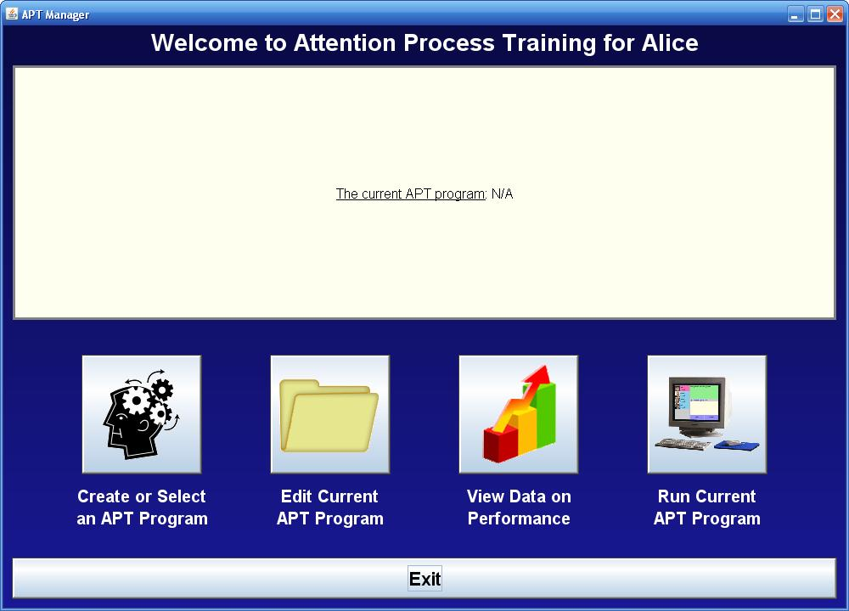

Slide 55
Principle 5
Actively facilitate generalization from the start of treatment
Examples of functional tasks/measurement
Increasing the amount of time the client can engage in a specified productive activity (e.g., reading, computer work, vocational task)
Decreasing the amount of cognitive effort it takes to complete a specified productive activity
Adding a desired, attentionally-demanding activity to one’s repertoire that has not been previously possible (e.g., driving)
Decreasing errors on specified activity
Decreasing completion time for a specified activity

Slide 56
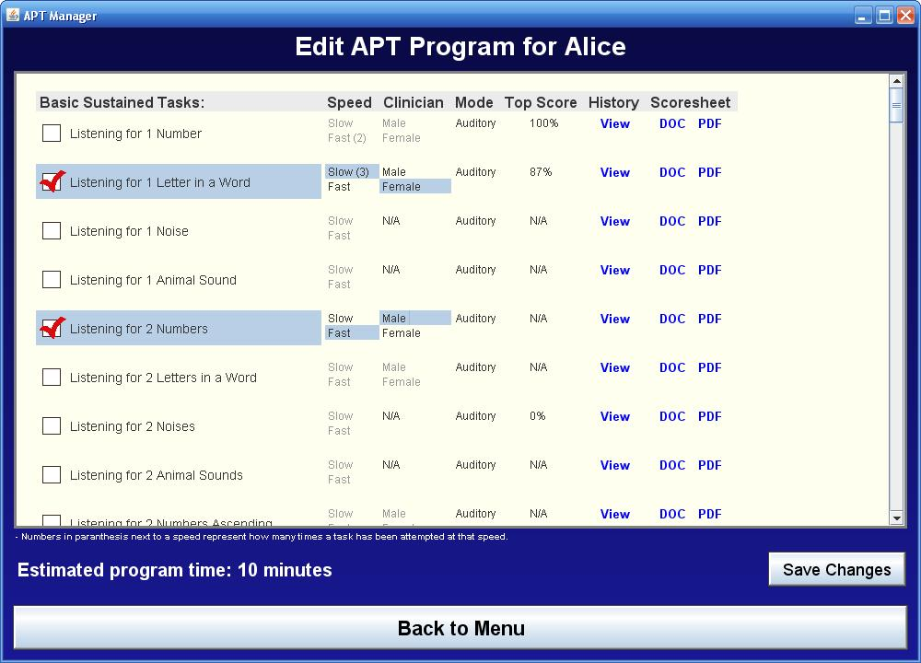

Slide 57
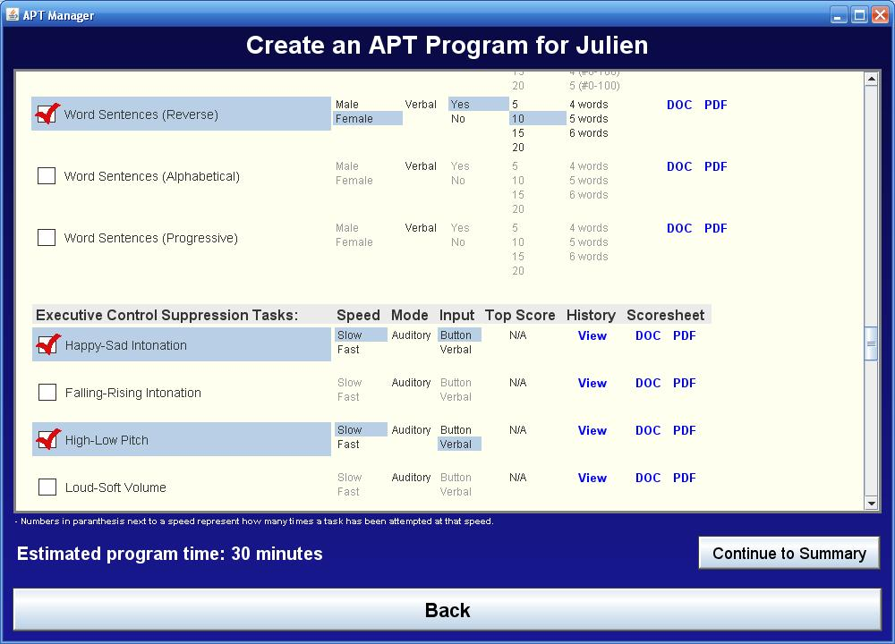
APT-3 task selection continued

Slide 58
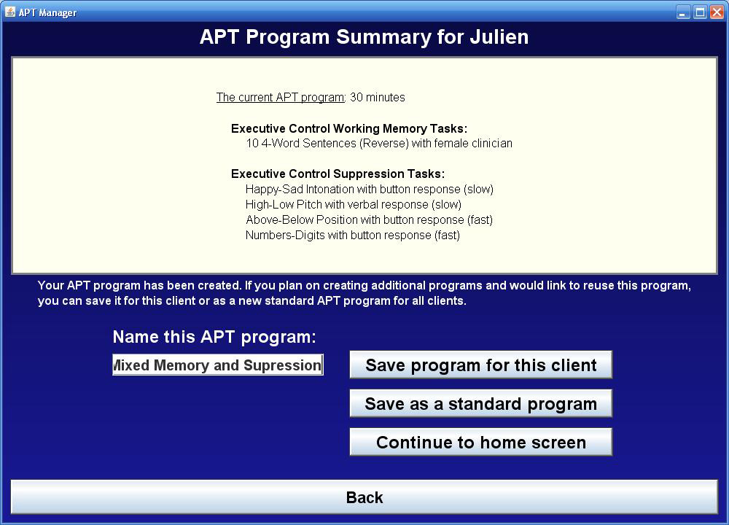
APT-3 program summary

Slide 59

Home Practice

Slide 60

Check in on homework—what did Sohlberg et al., (2014) say about factors that affect compliance.
If appropriate check in on generalization
Probe for ability to use strategy and understanding of purpose of exercise. Sample exercises from APT (organized by component that they address
Administer drills integrated with strategy
Measurement
Session
Home practice/Generalization/impact?
Performance on drills
Performance on strategy use
Outcome
GAS/Impact
Changes on standardized testing

Slide 61
You Should be able to…
Describe working memory and be able to draw and explain Baddeley’s model of the central executive
Describe clinical model of attention and generate examples of therapy tasks and real world tasks that correspond to the different types of attention
Understand the principles of direct attention training; describe evidence supporting it
Describe the program decisions that need to be addressed for direct attention training
Be able to give examples of other approaches for managing attention impairments
Identify standardized and nonstandardized measures of attention that could be used as outcome measures for attention training
Write a goal for attention training that contained all the necessary components
Give an overview of the research evidence

